Slide 1

BLOOD BANK SERVICES MANAGER
Project Supervisor: Mrs. Vinodhini
Name of the Student: Mr. Barukam Vamshi Yadav
Register Number: 39110138

Slide 2
Presentation Outline
Course Certificate
Introduction
Objectives
System Architecture / Ideation Map
Module Implementation
Application Snapshots
Results and Discussions
Conclusion & Future work
References

Slide 3
Course Certificate

Slide 4
Introduction
The population of the world is multiplying with each coming year and so are the diseases and health issues.
With an increase in the population there is an increase in the need of blood. The growing population of the world results in a lot of potential blood donors.
But in spite of this not more than of the total world population participates in blood donation.
With the growing population and the advancement in medical science the demand for blood has also increased. Due to the lack of communication between the blood donors and the blood recipients, most of the patients in need of blood do not get blood on time and hence lose their lives.

Slide 5
Objectives
The project blood bank services manager system is known to be a pilot project that is designed for the blood bank to gather blood from various sources and distribute it to the needy people who have high requirements for it.
The software is designed to handle the daily transactions of the blood bank and search the details when required.
It also helps to register the details of donors, blood collection details as well as blood issued reports.
The software application is designed in such a manner that it can suit the needs of all the blood bank requirements in the course of the future.

Slide 6
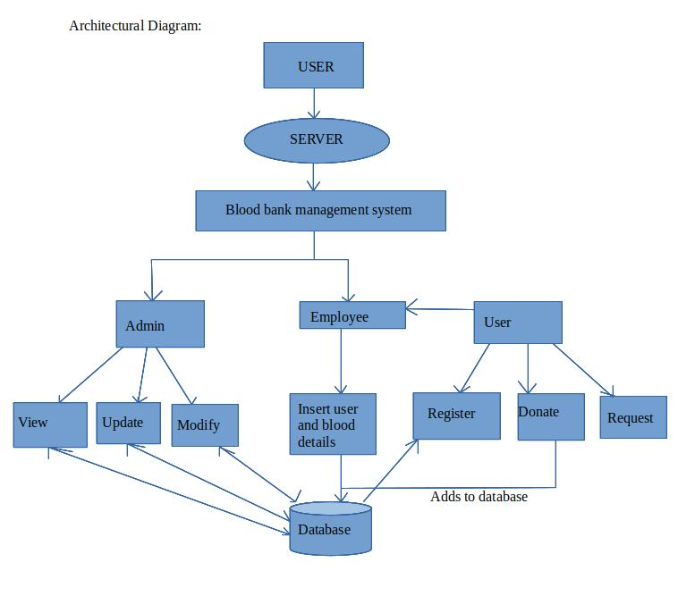
System Architecture

Slide 7
Proposed system
The proposed system (Blood Bank Management System) is designed to help the Blood Bank administrator to meet the demand of Blood by sending and/or serving the request for Blood as and when required.
The proposed system gives the procedural approach of how to bridge the gap between Recipient, Donor, and Blood Bank.
This Application will provide a common ground for all the three parties (i.e. Recipient, Donor, and Blood Bank) and will ensure the fulfillment of demand for Blood requested by Recipient and/or Blood Bank.

Slide 8
Methodology
The project blood bank services manager system is known to be a pilot project that is designed for the blood bank to gather blood from various sources and distribute it to the needy people who have high requirements for it.
The software is designed to handle the daily transactions of the blood bank and search the details when required.

Slide 9
Methodology
It also helps to register the details of donors, blood collection details as well as blood issued reports.
The software application is designed in such a manner that it can suit the needs of all the blood bank requirements in the course of the future.
This project in the Blood Bank Management System will develop an efficient system for blood transactions.

Slide 10
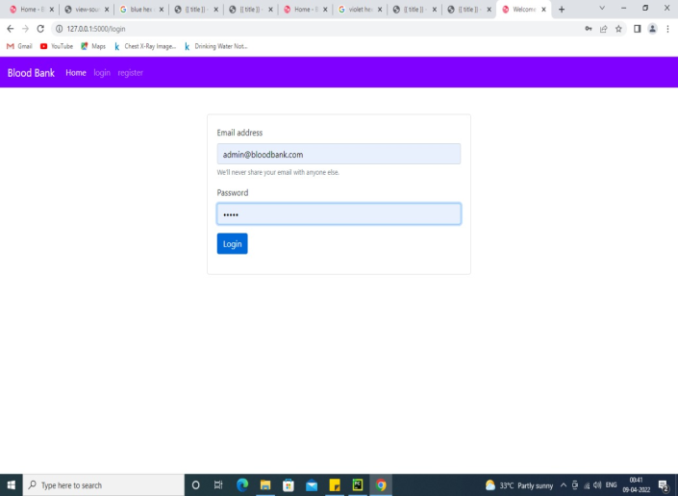
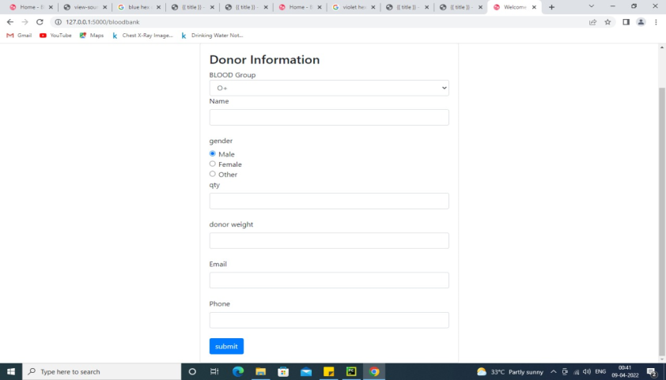
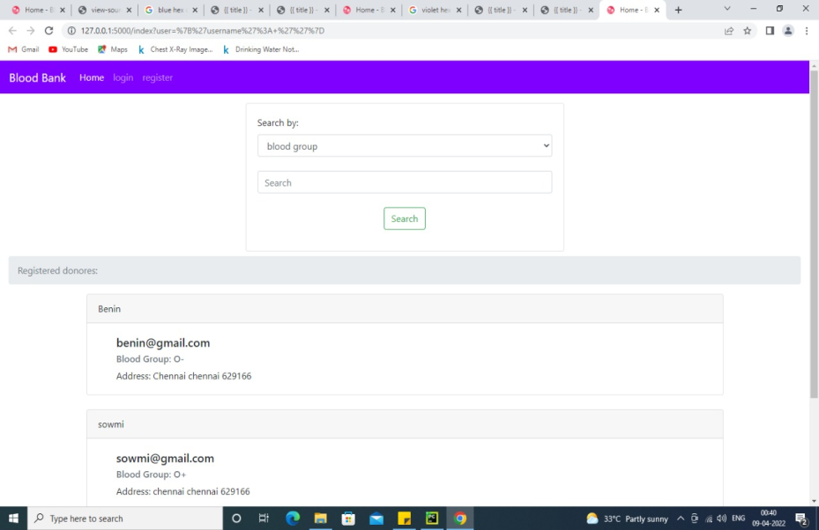

Application Snapshots

Slide 11
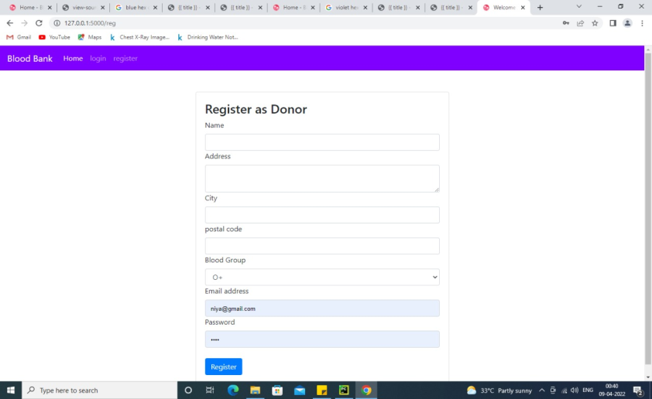
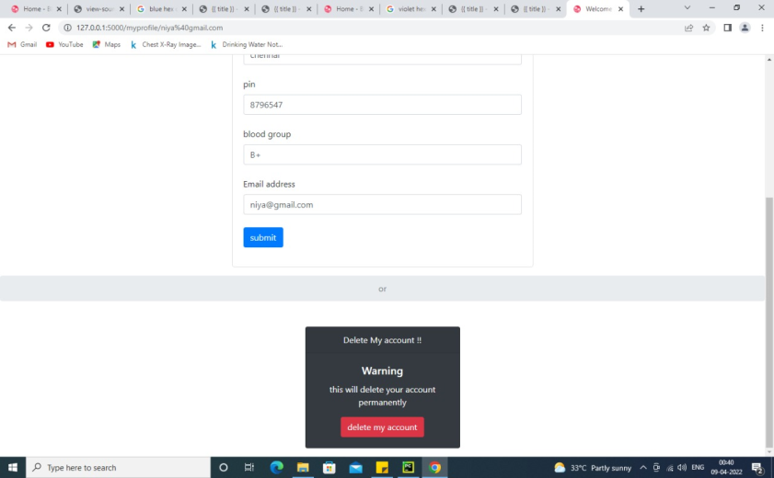
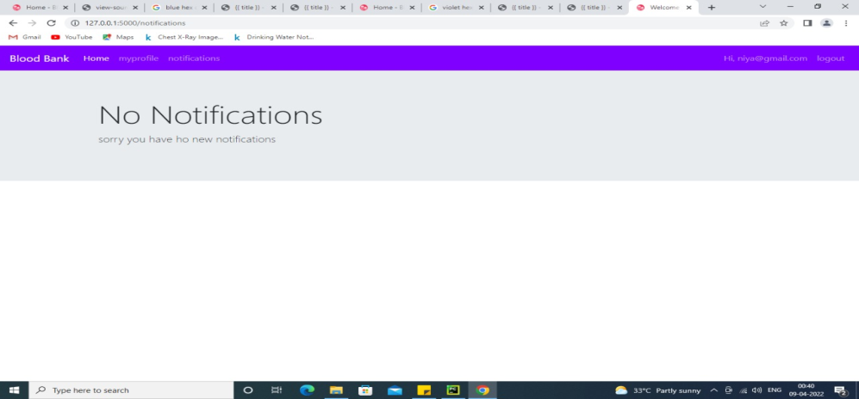
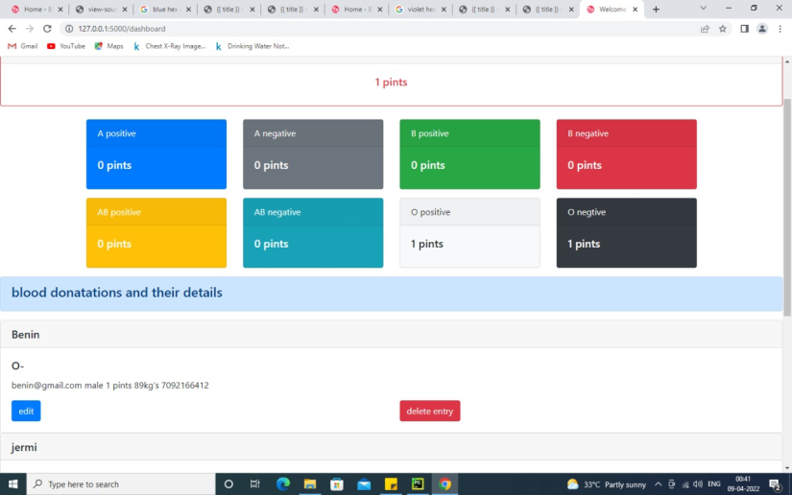
Application Snapshots

Slide 12
Results and Discussion
The Blood bank manager service web application contains the home page, contact page, donor details page, employee registration page, employee login page, dashboard, donate page, donor logs and the blood request page.
the administrative and inventory management within a blood bank. This project maintains all the information pertaining to blood donors, different blood groups available in blood bank and help them manage in a better way.
Also, project has provided transparency in this field, make the process of obtaining blood from a blood bank hassle-free and corruption-free and make the system of blood bank management effective.

Slide 13
Result
The web based blood bank manager service is created successfully and can be used by hospitals, blood banks, and people who are in need of blood. Many lives will be saved when the blood is donated at the right time and this application will achieve it

Slide 14
Conclusion
Technology is introducing new innovations day by day, thus reducing the time required to do things. The proposed system can be used to reduce the time required to deliver required blood to the needy in cases of emergency.The web application provides a way of communication and synchronization between the Donor and the blood bank. It also provides them with the facility of communicating with the donors in emergency. The database is a vital aspect of the system. The database of the needy and the blood bank must be checked for consistency on regular basis for smooth working of the system.
In today’s world, where we can do many things from home, just by pressing one click, we can take advantage of that concept by making online solutions for the shortage of blood donors. The management information system helps to reduce the use of paper, so the probability of errors should be minimal. Researchers believe that improving the management information system for the blood bank will make revolutionary improvements in the system. This web-based blood bank is a small contribution to serve mankind. It can save lives by educating the public about the benefits of blood donation, encourage them to donate, and manage the records of donors and people who need blood, to help the people who need blood to find the appropriate donors as soon as possible in quick, perfect, and a safe way ‒ with less effort.

Slide 15
References
BOOKS
Python: For Beginners A Crash Course Guide To Learn Python in 1 Week by Timothy C. Needham
MySQL: The Complete Reference by Vikram Vaswani
Flask Framework Cookbook by Shalabh Aggarwal
Essentials of Blood Banking by Mehdi S.R.
LINKS
https://docs.python.org/3/tutorial/
https://www.fullstackpython.com/flask.html
http://www.mysqltutorial.org/
https://www.javatpoint.com/mysql-tutorial
https://www.coursera.org/learn/python-databases
https://code.tutsplus.com/tutorials/creating-a-web-app-from-scratch-using-python-flask-and-mysql--cms-22972

